Slide 1
Emotus
Made by: Aksel Sundås, Kristin Seip Stubbe, Tedros Kiflom, Frida Gustavsson & Ludwig Oelker

Slide 2
Background
Description of application
An app that takes input from the user and returns an emotion
Nice to have
Pick a mood and get an equivalent song as a result
Must haves
Search function
Log searches as cookies
Database/API with songs and lyrics
Integration with text analyzer
Lvl 0 = return a bolean (isHappy)
Lvl 1 = return a string
Lvl 2 = return a picture
Lvl 3 = return a picture that is generated with AI(Dall-e2)
Integration towards a picture API
Integration towards OpenAI(Dall-e2)
Notes:
Ludwig

Slide 3

Project idea
Problem
Allows for interpretation of lyrics from a song
Helps people with accessibility needs
Tech Stack
Java
Spring MVC, Spring Boot, UniRest, JSON
JavaScript
HTML & CSS
API’s
Sustainability
Helping people with specials needs
Supporting learning and integration into society
Notes:
Ludwig

Slide 4
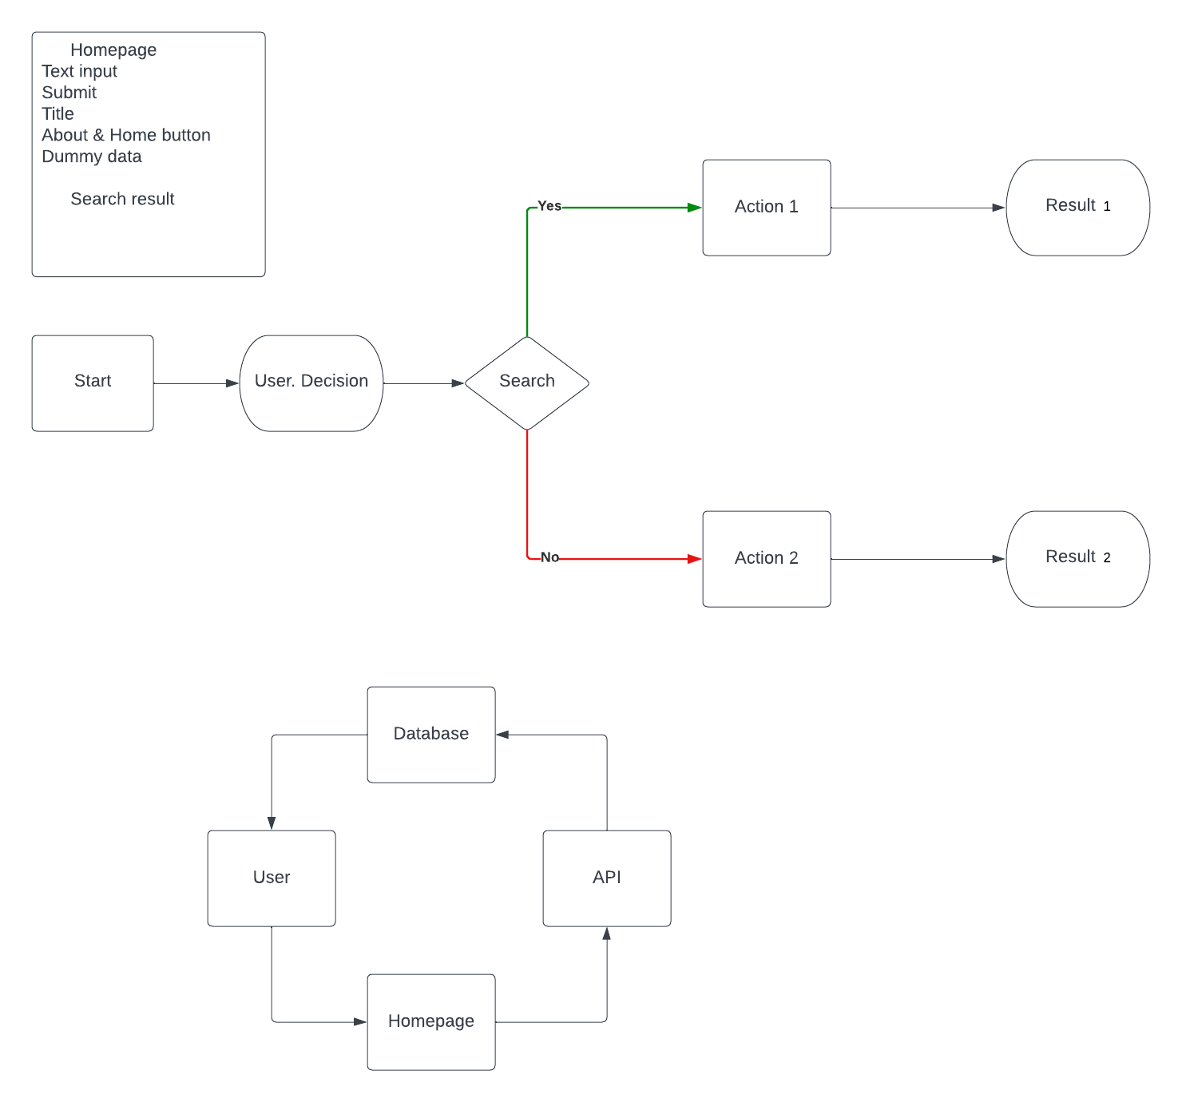
Planning
Notes:
Tedros

Slide 5
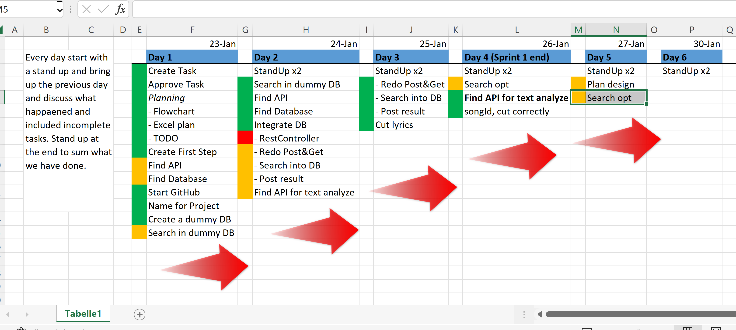
Notes:
Tedros

Slide 6
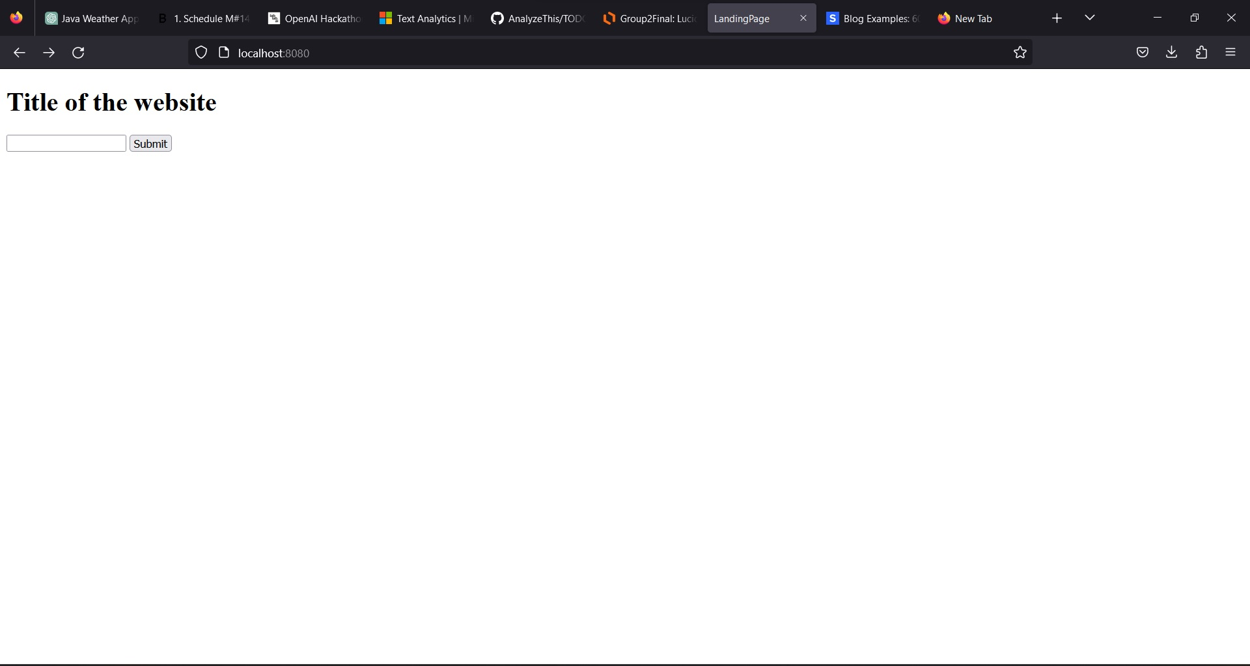
First day
Notes:
Aksel

Slide 7
Notes:
Aksel

Slide 8
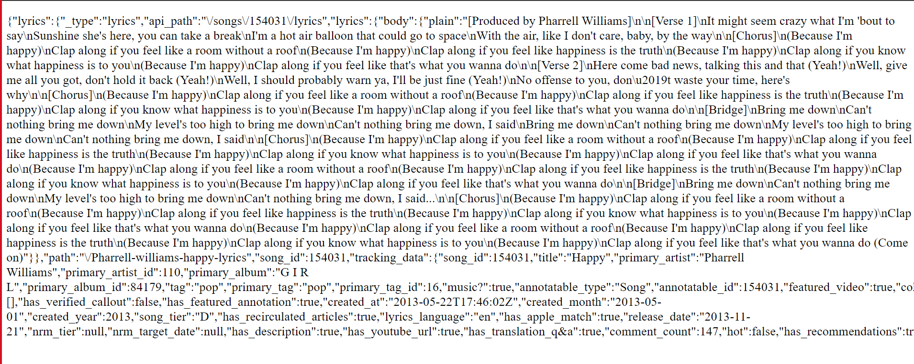
Notes:
Aksel

Slide 9
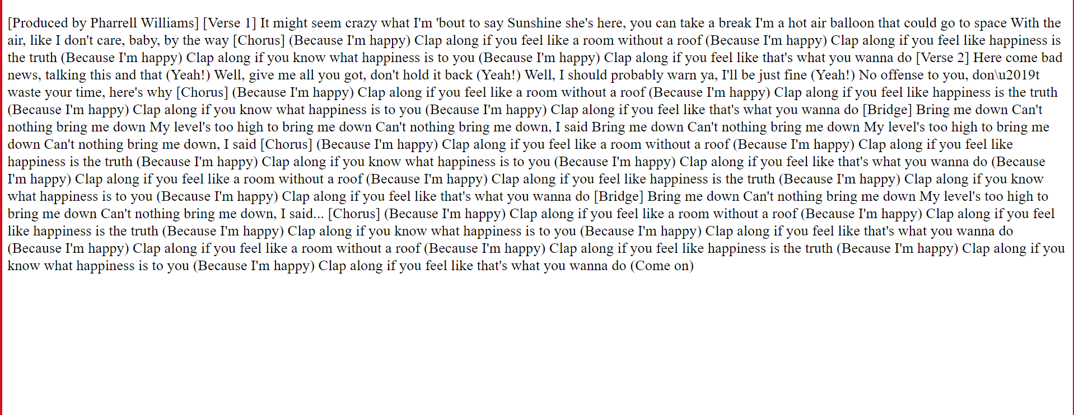
Notes:
Aksel

Slide 10
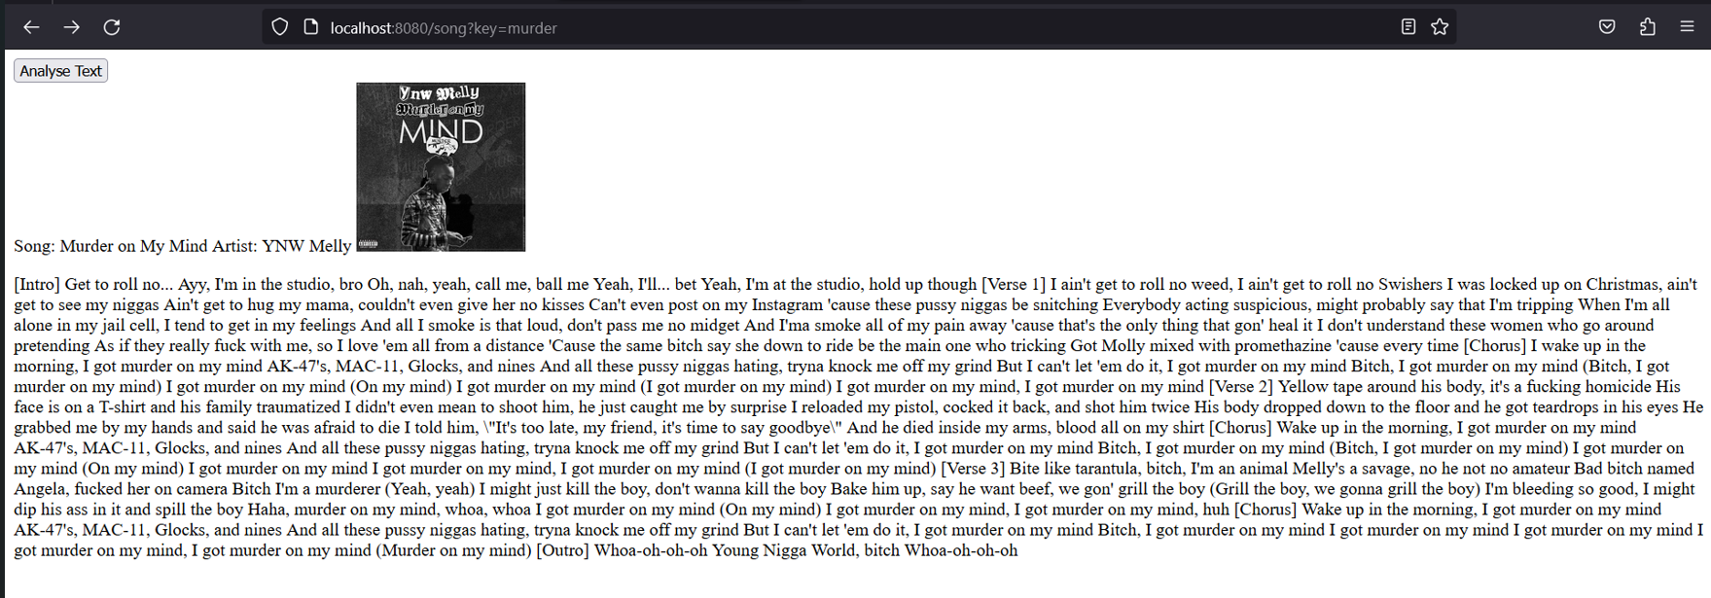
Notes:
Frida

Slide 11
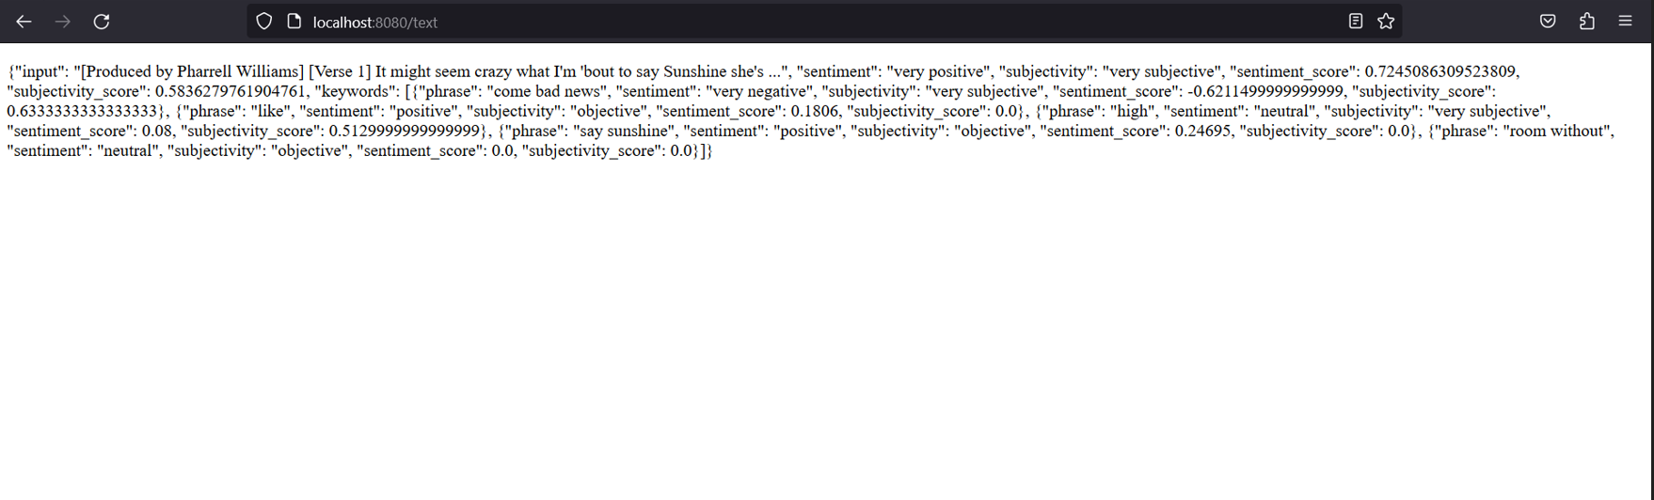
Notes:
Frida

Slide 12
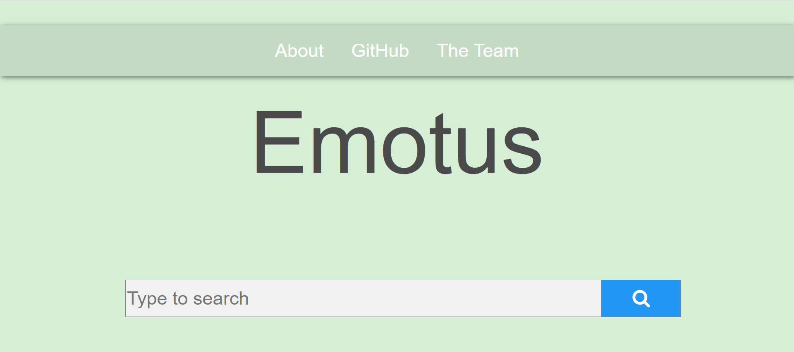
Notes:
Frida

Slide 13

Demostration
http://localhost:8080/
Notes:
Tedros

Slide 14
The Substringers
Division of work
TODO
Mob code in the start
Split group once progress slows
Rebase every now and then
Agile methodology
Standup at the start and end
Retro perspective
Adaptive planning
Challenges/Learnings
The unknown…
Frontend takes time
Knowing when and what to split up
API
Notes:
Kristin

Slide 15
Group reflection
Pictures used to reflect feelings might not be correct
Text could be ambiguous
Emotus has subjectivety analys
The actual music is not analysed
Song could sound sad, but lyrics could be positive
kjuh
Notes:
Ludwig

Slide 16
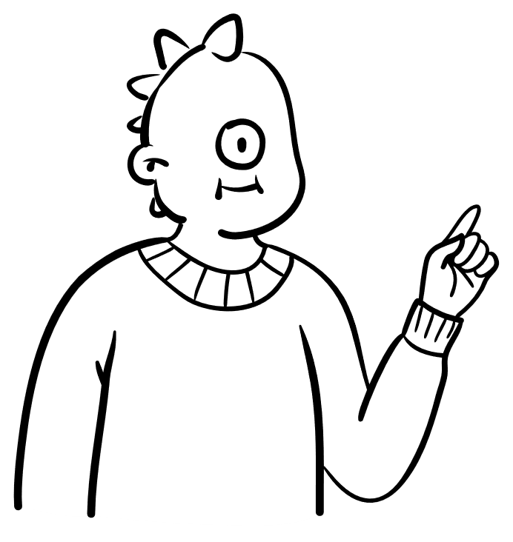

Next steps
Future?
Collaborate with special needs organizations
Create our own API/text analysis
Apply for government grant
Or sell to local commune
Emotus 2.0
Integrate picture AI
Hide API key…
Add security
HttpSession
Upload on server
Notes:
Kristin

Slide 17
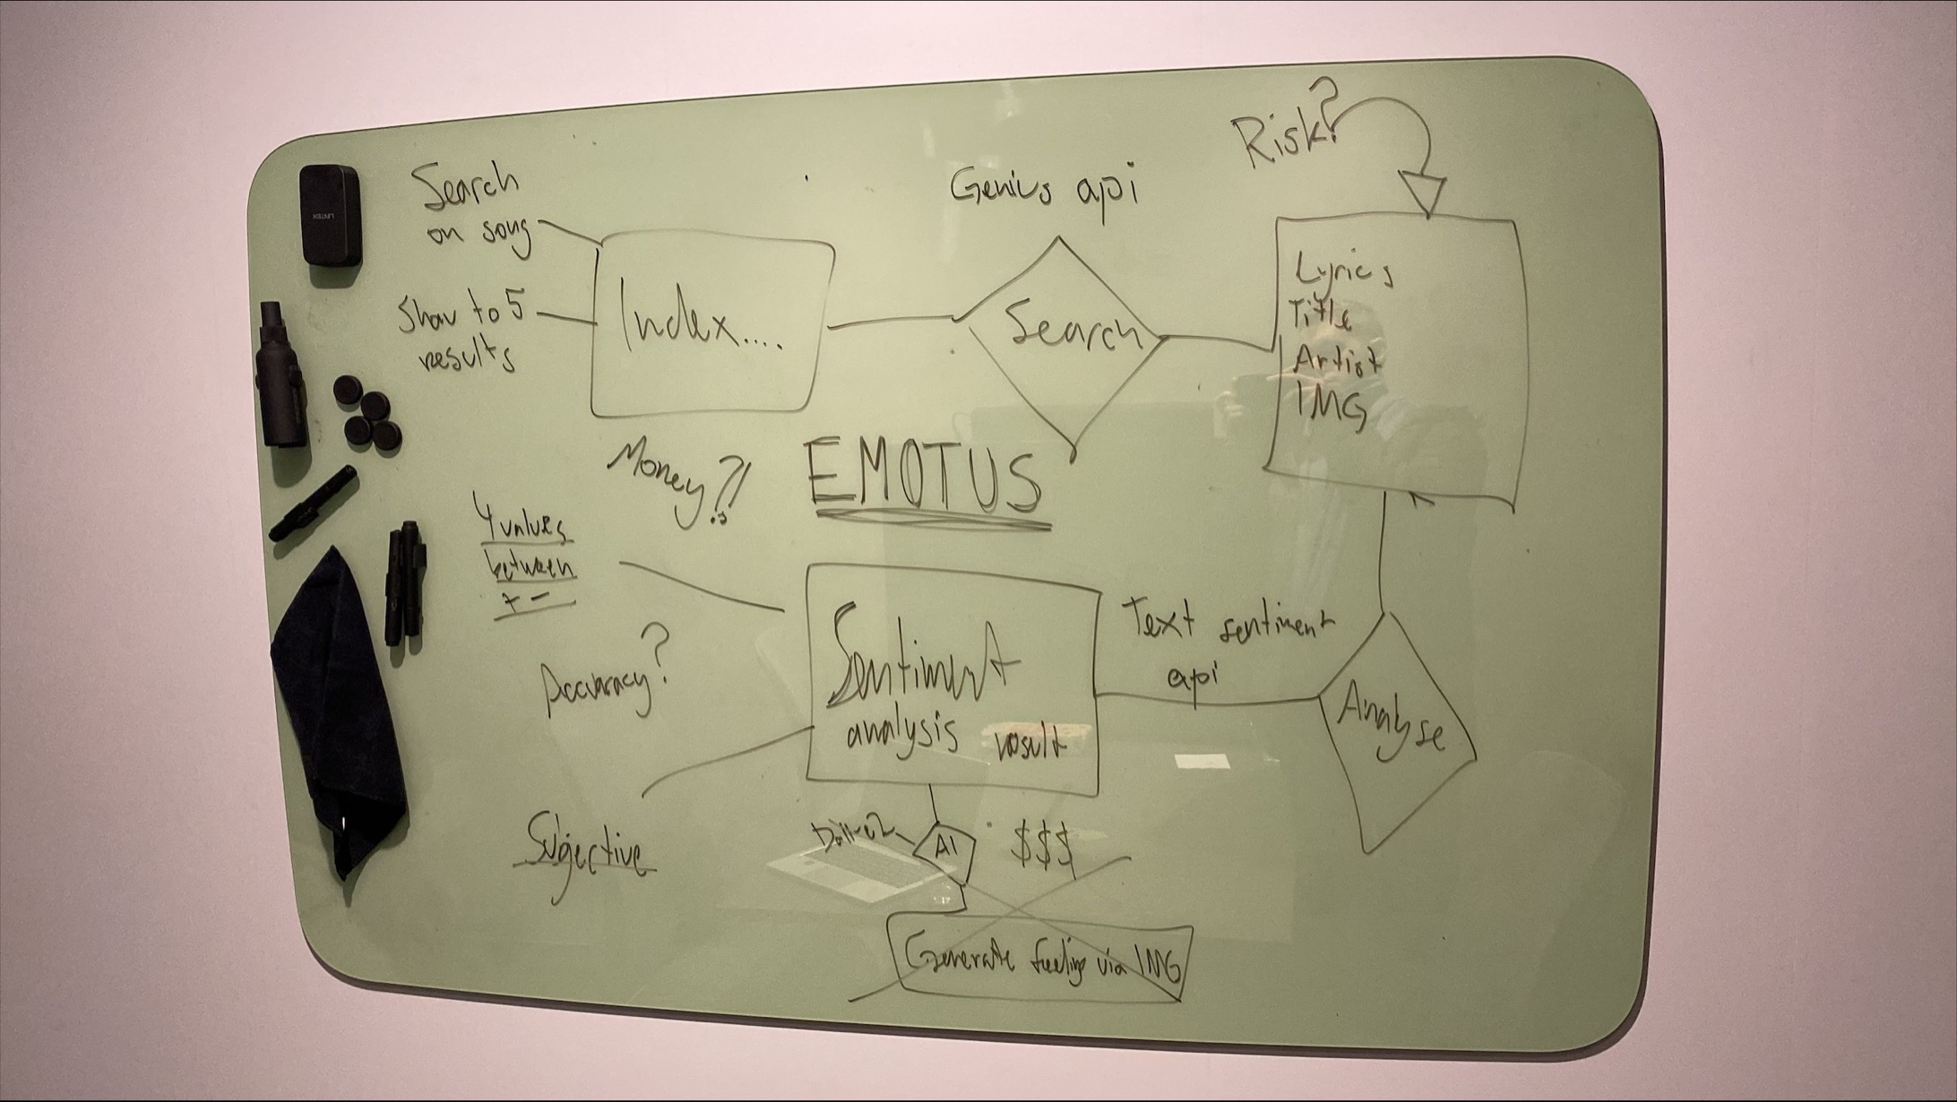
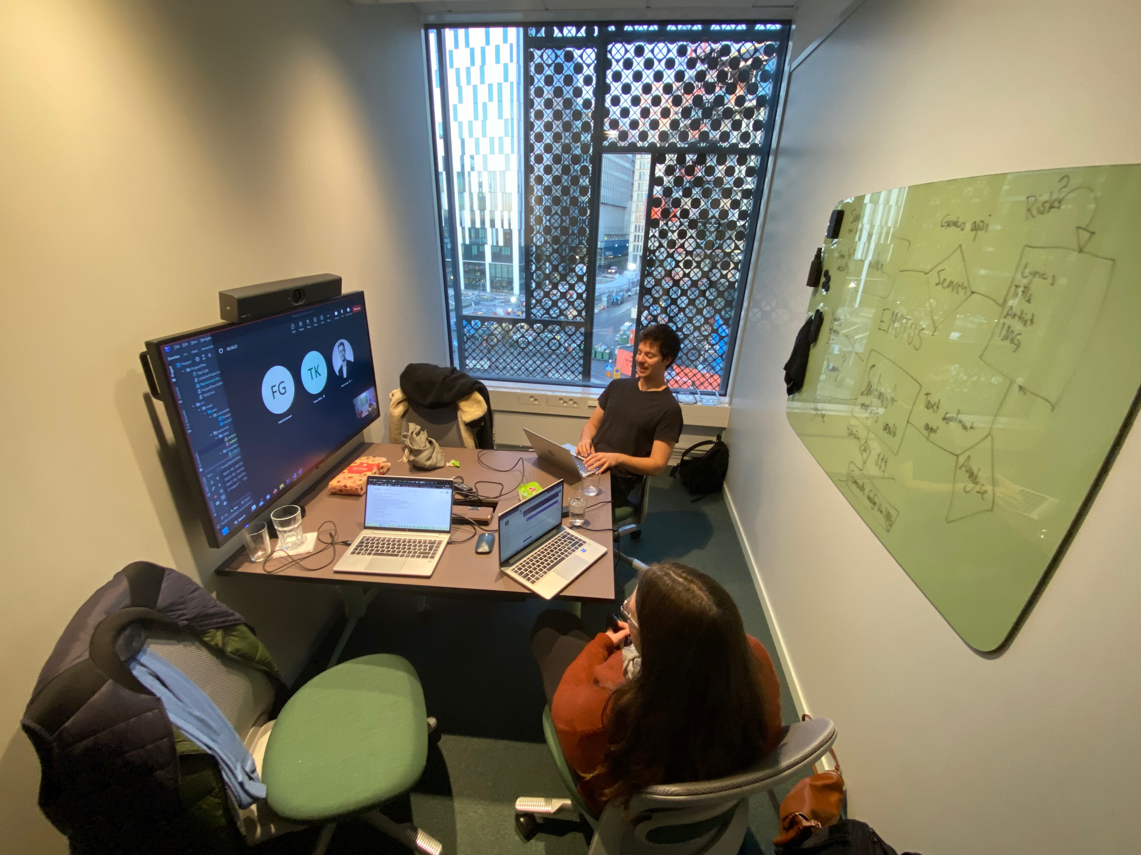
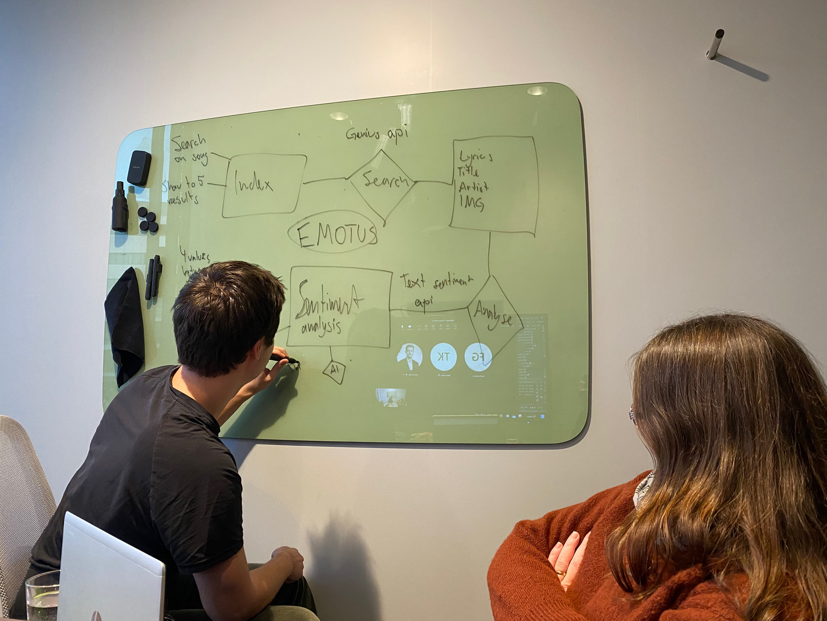
Snapshots

Slide 18
TODO
Add final pictures of the project
Show more code
Visa unit tests
Själv kritik

